Slide 1

LangTriage
Classification of Patient Free-Text Symptom Descriptions by Urgency
Final Presentation
Team members:
Nofar Kedmi
Diana Akoshvili

Slide 2
Project Description
CHALLENGE:
Hospitals, especially emergency rooms, are overwhelmed with patients presenting a wide variety of medical complaints, often using informal language and vague phrasing.
Triage decisions must be made quickly to prioritize care and ensure that urgent cases are treated first — but this manual process is time-consuming and can lead to delays.
OUR SOLUTION:
Developing an NLP model based on a Large Language Model (LLM) to classify patient symptom descriptions into:
0 — Not urgent: Can wait or be monitored
1 — Urgent: Requires immediate medical attention
GOAL:
Support faster and more accurate triage decisions.

Slide 3

Project Objectives
Exploring Different Aspects and Solutions to Our Problem
Assess the impact of different text representations methods - classical vectorization (TF-IDF) versus contextual embedding (transformers) - on classification accuracy.
Fine-tune transformer-based models like DistilBERT and T5 alongside a traditional
TF-IDF + Logistic Regression baseline, and compare their performance.
Analyze the models’ ability to handle imbalanced datasets and noisy clinical narratives.

Slide 4
Task Specification
Input: Natural text generated from structured clinical measurements.
Output: Classification labels indicating urgency level (0 or 1).
Metrics: Classification Accuracy, F1-Score, Recall, Precision.
From Clinical Indicators to Urgency Prediction - Subtasks:
Data Generation/Labeling: Generate a labeled dataset by converting structured clinical measurements into patient natural language free-text descriptions using GPT-4o. These descriptions will serve as inputs for the models.
Training: Fine-tune transformer-based models such as DistilBERT and generative T5 on the generated dataset and train a traditional baseline model using TF-IDF with Logistic Regression to classify patient urgency levels accurately.
Evaluation: Evaluate and compare the performance of the fine-tuned models against the baseline.

Slide 5
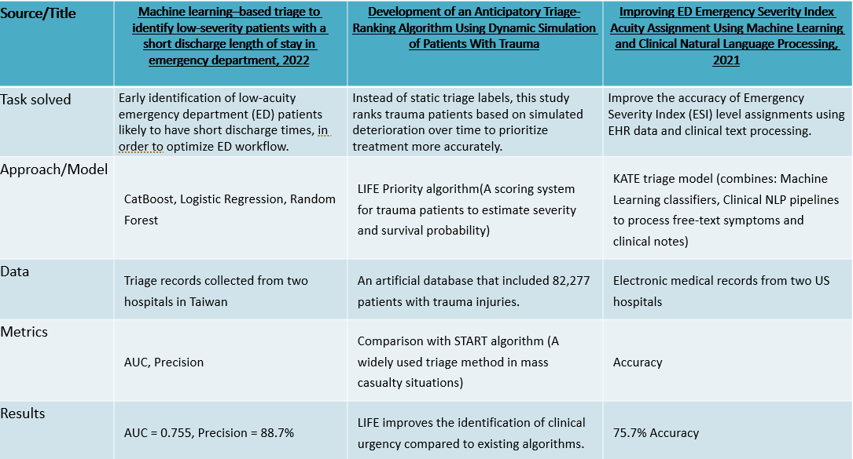
Prior Art

Slide 6
Methodology - Data Preparation
Source dataset description:
Patient Priority Classification dataset, sourced from Kaggle.
The dataset contains clinical measurements and triage labels for patients arriving the ER.
For example: BMI, Blood pressure, Insulin, Glucose, Cholesterol, Heart disease, Exercise angina, Chest pain.
Data generation:
Structured Prompt was designed for the GPT-4o model to generate natural, first-person, free-text descriptions without medical terms, simulating how a patient might describe their symptoms upon arrival at the emergency room. These were based on the patient’s clinical measurements.
New Fields:
'text_input' column: Contains synthesized patient complaint texts generated by GPT-4o, used as model input.
‘label’: binary urgency labels (0 = Not Urgent, 1 = Urgent).

Slide 7

Methodology - Data Preparation
Data properties:
6962 patient records with 17 structured clinical features.
'label' distribution after SMOTE: 4,861 samples for Not Urgent (0) and 4,861 samples for Urgent (1).
Average input length (patient description): 35 words.
Patient case examples:
“I'm a 54-year-old male. I feel a tight feeling in my chest and kind of dizzy, it's weird. I can't keep up with simple tasks around the house, it's like my energy is gone".
"I’m 34. Since this morning my heart has been beating really fast. It gets worse when I move, but I still feel it even when I sit. I’m tired all the time, even when I’m not doing anything, and it scares me."

Slide 8
Models & processing pipeline
Model | Data Split | Epochs | Learning Rate | Batch Size (Train/Eval) | CPU/GPU | Input Max Length
TF-IDF + LR | 80/20 stratified | No epoch-based training | Not applicable (solver) | None | CPU | Not applicable
DistilBERT (fine-tuned) | 80/20 stratified | 3 | 0.00002 | 16 / 32 | GPU (Tesla T4) | 128
T5 (fine-tuned) | 80/20 stratified | 3 | 0.00005 | 16 / 16 | GPU (Tesla T4) | 128
*All models were executed in the Google Colab environment.

Slide 9
Pipeline
Structured Patient Data
Demographics, Vital Signs, Lab Values, Pain Scale
Tokenization & Vectorization
Data Cleansing & Map Labels to binary format
Treat missing/invalid data. (Urgent = 1, Not Urgent = 0)
Urgency Prediction
Models Output Binary classification: (0 or 1)
Prompt Creation
"You are patient arriving to the ER. Describe how you feel, use simple, natural language without medical terms"

Slide 10
Metrics
How the metrics were compared ?
During Training (Validation Set)🔬
During Evaluation (Test Set) 📊
Loss Function
Accuracy
Accuracy
Precision
Recall
F1-score
AUROC

Slide 11
Code Organization
Link to GitHub
Data files: (Format: CSV)
patient_priority - Raw dataset as provided, includes triage info and clinical indicators
df_clean_original - Cleaned version with mapped binary labels
df_clean_with_text - Final dataset including structured input and free-text complaint
Code Notebooks:
EDA: NLP_Project_EDA.ipynb
Free-Text Generation: Generate_free_text_complaints.ipynb
Training: Train_and_Evaluate_models.ipynb
Model Comparison: Comparison_of_Model_Performance.ipynb

Slide 12
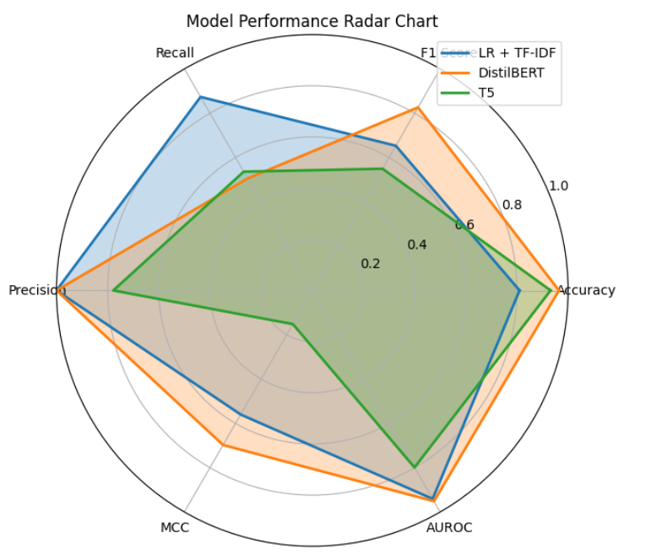
Results
Comparison of model performance on the test set:
Metric/Model | TF-IDF + LR | DistilBERT | T5
Accuracy | 0.8101 | 0.9641 | 0.9314
F1-Score | 0.6530 | 0.8262 | 0.5494
Recall | 0.8734 | 0.5939 | 0.5360
Precision | 0.9999 | 0.9999 | 0.7778

Slide 13
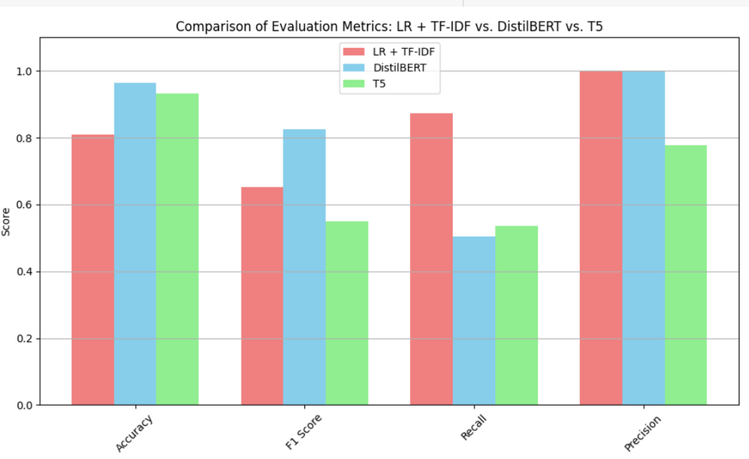
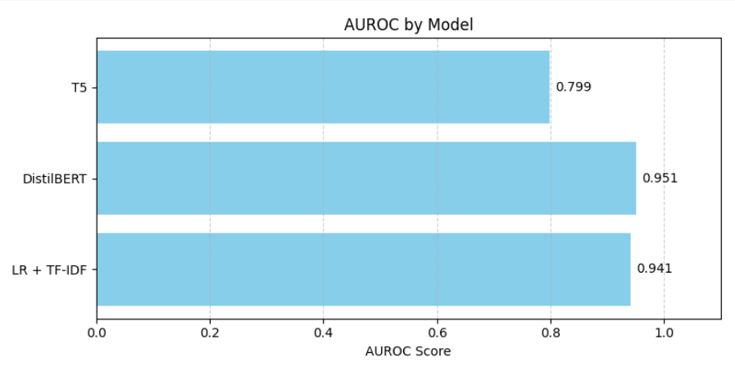
Results
DistilBERT demonstrated the most balanced and superior performance across all metrics, achieving the highest AUROC and F1-score.
TF-IDF + Logistic Regression showed strong recall, indicating high sensitivity to urgent cases, but with lower precision and overall accuracy.
T5 achieved good overall accuracy, but demonstrated weaker consistency in classification metrics such as
F1-score and recall.

Slide 14



Conclusions & Recommendations for Future Work
Improving Recall in transformer models:
Recall was relatively low. Future work can explore threshold tuning or smarter sampling to improve urgent case detection.
Enhancing synthetic text generation: Texts can be made more natural and diverse using larger models or clinical fine-tuning.
Real-world clinical validation: Test the model in actual ER settings and gather staff feedback on its usefulness in triage decisions.

Slide 15
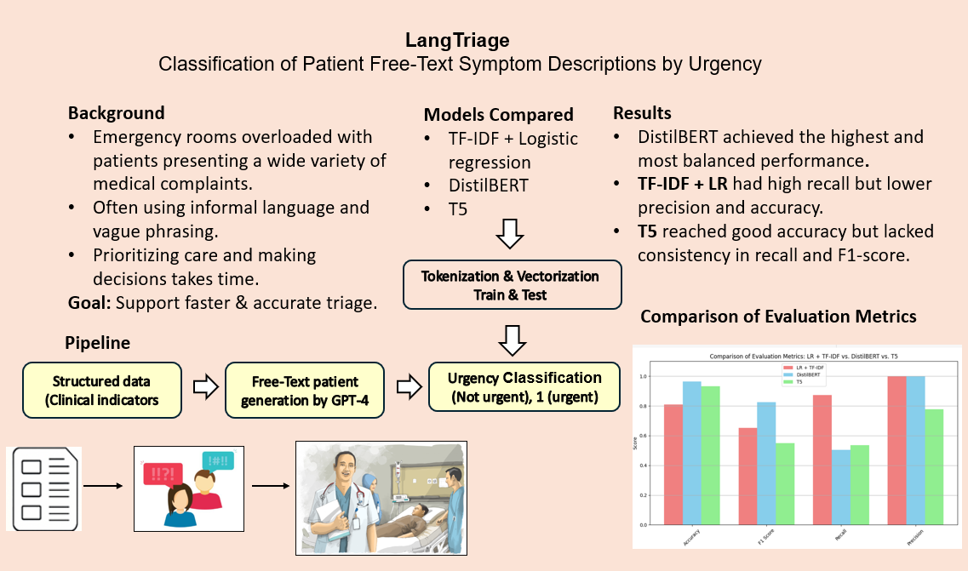
Visual Abstract

